Slide 1







Enterprise Blockchain Developers (Intermediate)
In support of
Powered By

Slide 2
Outline
Fallback Proxy
Docker
Docker Compose
Node js and Express js
© 2017-2020 SmartMesh Foundation Pte. Ltd. | MeshBox Foundation Pte. Ltd.

Slide 3
Basic Elements in an Application
Login/ Logout/ Signup (session / JWT)
Forms
File uploading
Data rendering and passing among application components (frontend backend/ mvc)
Database and databased design
© 2017-2020 SmartMesh Foundation Pte. Ltd. | MeshBox Foundation Pte. Ltd.

Slide 4
What are Node and Express js
What is Nodejs
Nodejs is a backend framework.
what is a backend?
In the computer world, the "backend" refers to any part of a website or software program that users do not see. It contrasts with the frontend, which refers to a program's or website's user interface. In programming terminology, the backend is the "data access layer," while the frontend is the "presentation layer."
What is expressjs?
ExpressJS is a web application framework built on top of Nodejs that provides you with a simple API to build websites, web apps and back ends.

Slide 5
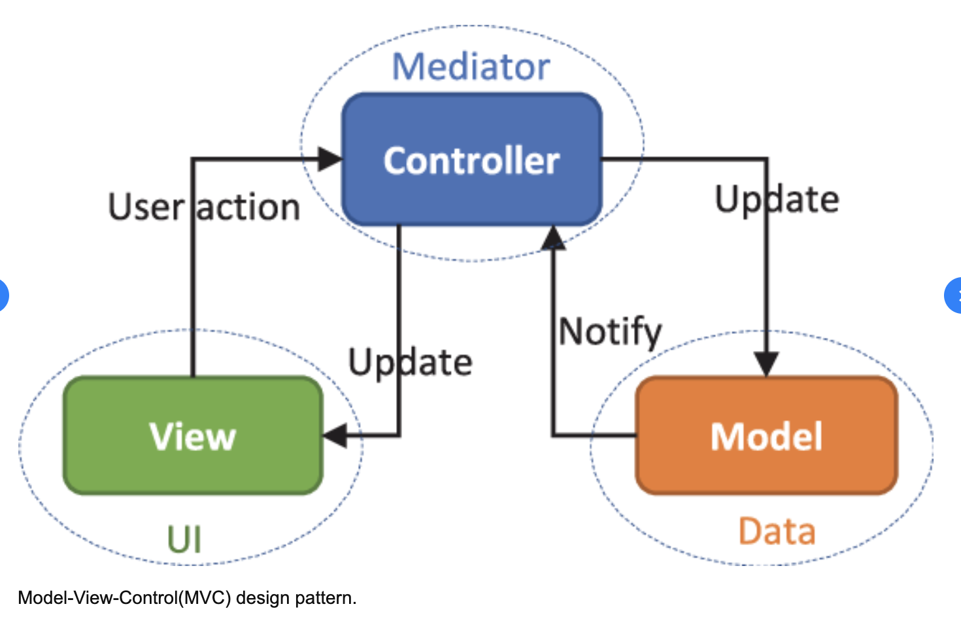
MVC Model
Model-View-Control

Slide 6
MVC Model
Model
The central component of the pattern. It is the application's dynamic data structure, independent of the user interface.[5] It directly manages the data, logic and rules of the application.
View
Any representation of information such as a chart, diagram or table. Multiple views of the same information are possible, such as a bar chart for management and a tabular view for accountants.
Controller
Accepts input and converts it to commands for the model or view

Slide 7
MVC Model
MVC Model Programming Steps: Node and Express js
Steps:
1. Setting up an Express App
2. Adding middleware
3. Setting up database connection
Iterating process:
3. Writing routes and controller
4. Defining corresponding data models
5. Writing corresponding html

Slide 8
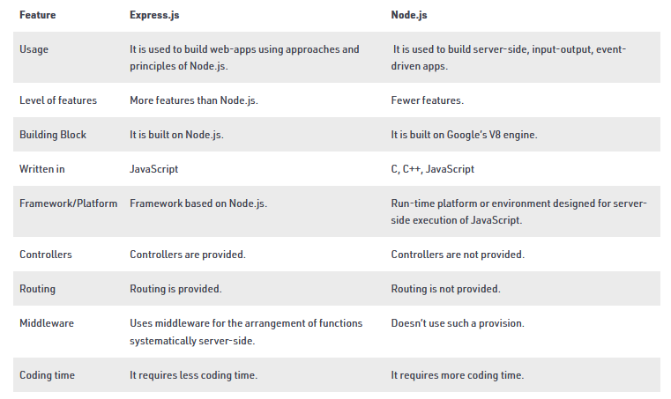
What are Node and Express js
Deffierence

Slide 9
SQL
Query: Select * from table_name
Insert:
INSERT INTO users (id, name, email, password, createdAt, updatedAt)
VALUES (3, "bing", "we@qq.com", "123","","");
Deletion: DELETE from users WHERE name = "bing";
Update: UPDATE table_name SET field1=new-value1, field2=new-value2 Where
count, distinct, max, min, sum
select keyword() from users where xxx;

Slide 10
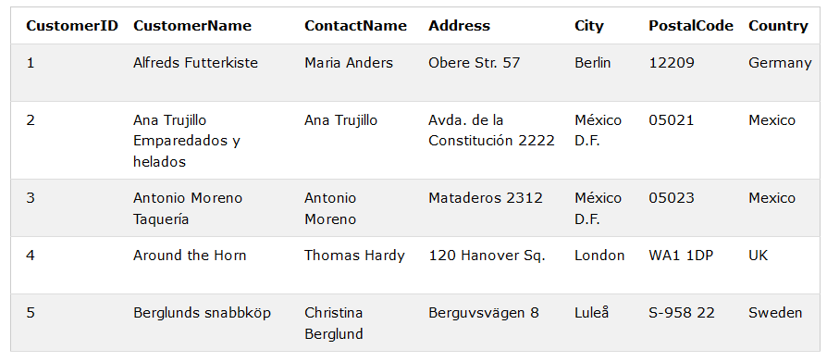
SQL
Ordering
SELECT column1, column2, ...
FROM table_name
ORDER BY column1, column2, ... ASC|DESC;

Slide 11
SQL
Grouping
SELECT column_name(s) / max(column_name)
FROM table_name
WHERE condition
GROUP BY column_name(s)
ORDER BY column_name(s);

Slide 12
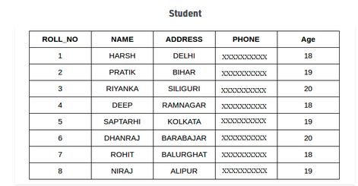
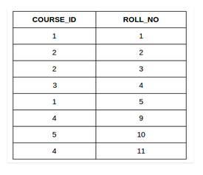
SQL
INNER JOIN, LEFT JOIN, RIGHT JOIN, FULL JOIN

Slide 13
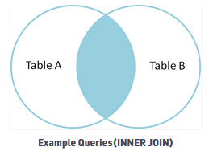
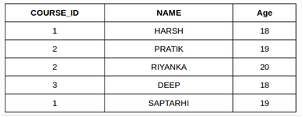
SQL
INNER JOIN
SELECT table1.column1,table1.column2,table2.column1,....
FROM table1
INNER JOIN table2
ON table1.matching_column = table2.matching_column;

Slide 14
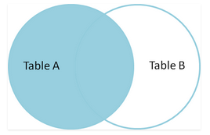
SQL
Left JOIN
SELECT table1.column1,table1.column2,table2.column1,....
FROM Student
LEFT JOIN studentcourse
ON table1.matching_column = table2.matching_column;

Slide 15
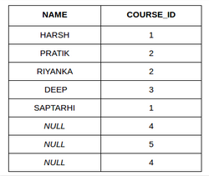
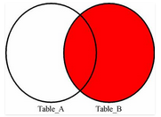
SQL
RIGHT JOIN
SELECT Student.NAME,StudentCourse.COURSE_ID
FROM Student
RIGHT JOIN StudentCourse
ON StudentCourse.ROLL_NO = Student.ROLL_NO;

Slide 16
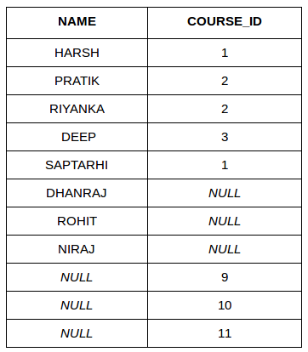
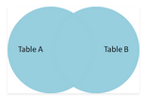
SQL
Full JOIN
SELECT Student.NAME,StudentCourse.COURSE_ID
FROM Student
FULL JOIN StudentCourse
ON StudentCourse.ROLL_NO = Student.ROLL_NO;

Slide 17
DataBase Design
Why need to master database design?
A semi decenetralized staking app.
ratio is the staking rate; profile is daily yield
this is a real example. Problem?
ratio and profit cannot be indexed and fast queried, if I would like to know which token has the highest exchange rate
the real requirements: the client hope that the user could do signal token withdraw. so just need to replace that token rate in the whole string.
This design will cause lots of troubles when there are new fetures, probably will rewrite the whole application later

Slide 18
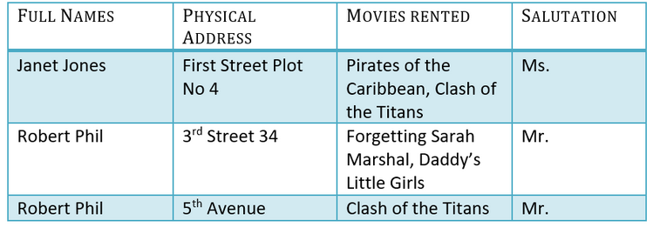
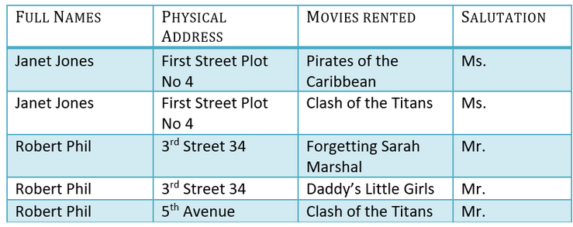
DataBase Design
1NF 2NF 3NF:
1NF: Each table cell should contain a single value.

Slide 19
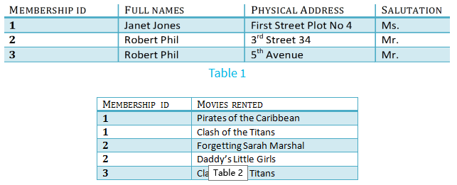
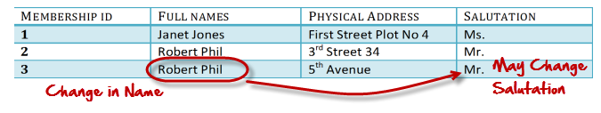
DataBase Design
2NF: Single Column Primary Key
3NF: Has no transitive functional dependencies
A transitive functional dependency is when changing a non-key column, might cause any of the other non-key columns to change

Slide 20
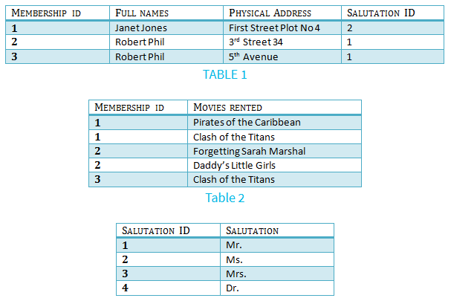
DataBase Design
3NF

Slide 21
MVC Code Demo Requirements: Registration
Requirements:
1. Design database models: Using SQLite3
2. Write Login, Logout, and Dashboard home page
3. Write controller to interact with database through Models and rendering views
Do Code Demo Later

Slide 22
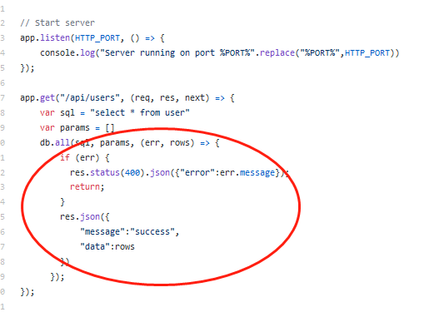
Problem Without Model
https://github.com/onebit256/node-express-rest-api-example (Explain the code)
Without using Model
If we want to change the data query logic, we have to change the controller's logic

Slide 23
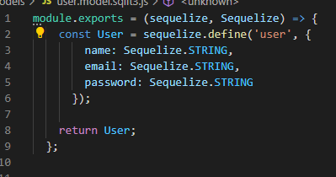
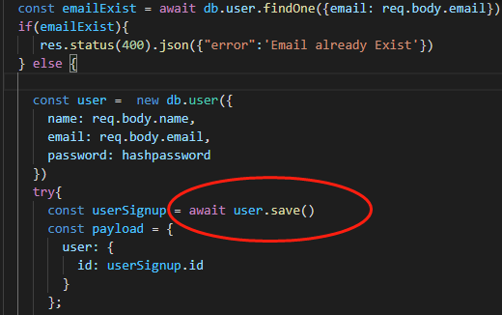
Problem Without Model
https://github.com/onebit256/node-express-react-demo-project (Explain the code) With Model
*
if we want to change the logic of
data save function, we don't neet to
change the controller's logic
program is more readable
easier to understand other's code

Slide 24
Sequelize
What is Sequelize ?
Sequelize is a promise-based ORM for Node.js v4 and upwards. It supports the dialects PostgreSQL, MySQL, SQLite and MSSQL and features solid transaction support, relations, read replication and more.
What is ORM ?
An ORM is known as Object Relational Mapper
ORMs save time in writing raw SQL queries thereby reducing development time.
out of box query
Example
select *from user => user.findAll()
select * from user where => user.find()

Slide 25
MVC Code Demo Requirements: Registration
Requirements:
1. Design database models: Using SQLite3
2. Write Login, Logout, and Dashboard home page
3. Write controller to interact with database through Models and rendering views
Code Demo Now
How to write a program from scratch

Slide 26
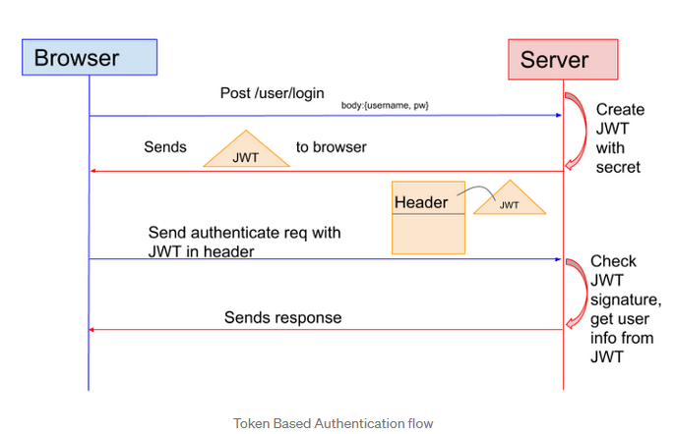
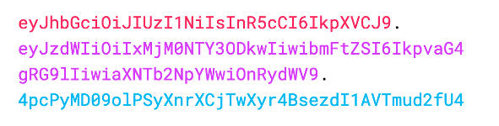
JsonWebToken(JWT)
What is JWT

Slide 27
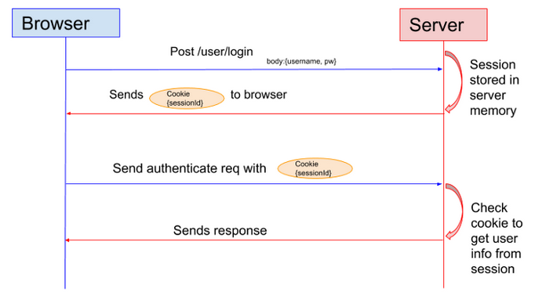
JsonWebToken(JWT)
JWT vs Session
Drawback: the Session cannot be verified cross servers for the cluster, unless stored in database

Slide 28
Request Type
Get Request (code demo)
the parameters are taken in url
Post Request(code demo)
the parameters are taken in request playload
demo Postman, project interaction

Slide 29
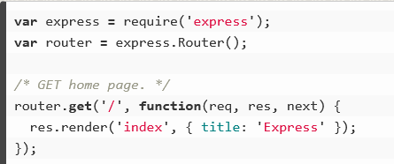
Send Parameters to the View
Code Demo
Compare a normal program with a api program

Slide 30
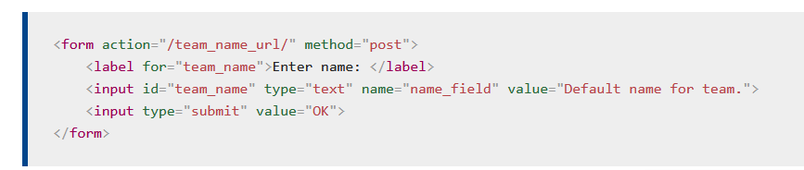
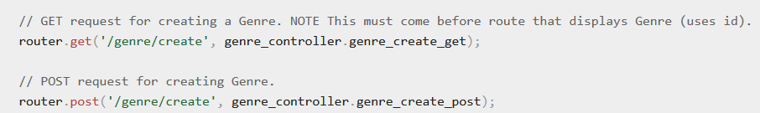
Form
1 specify Router
2 specify the request type, usually POST for Forms
Form will take inputs value as parameters to send to the server
action should match routes, then the route will call the controller function to handle the request. In this case, put action = /genre/create

Slide 31
File Upload
https://www.geeksforgeeks.org/file-uploading-in-node-js/

